Slide 1
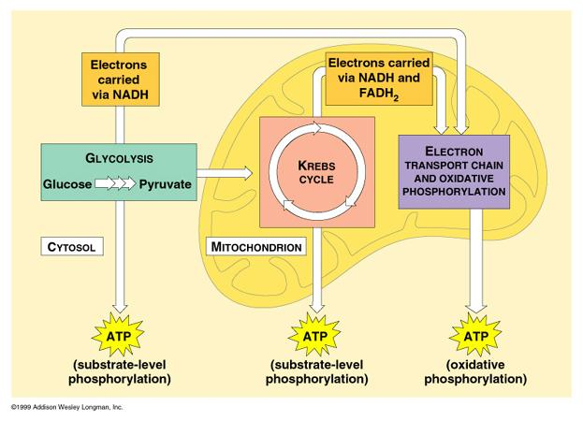
Cellular Respiration

Slide 2
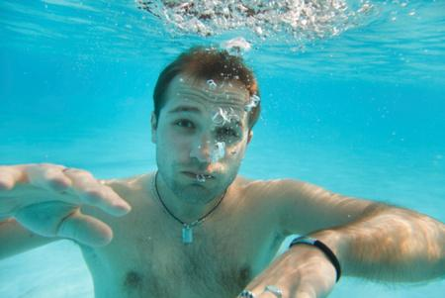
Cellular Respiration
Have you ever wondered why exactly you need to breathe? What happens when you stop breathing?

Slide 3
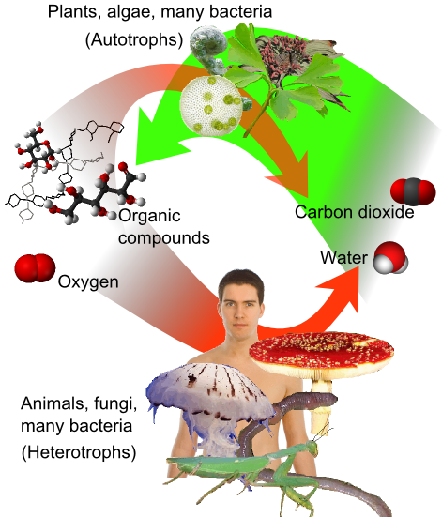
Cellular respiration is the set of metabolic reactions and processes that take place in the cells of organisms to convert biochemical energy from nutrients into adenosine triphosphate (ATP), and then release waste products.

Slide 4
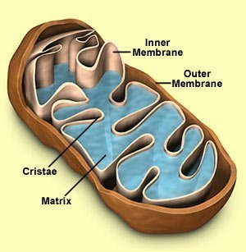
Where Does Cellular Respiration Take Place?
It actually takes place in two parts of the cell:
Glycolysis occurs in the Cytoplasm
Krebs Cycle & ETC Take place in the Mitochondria

Slide 5
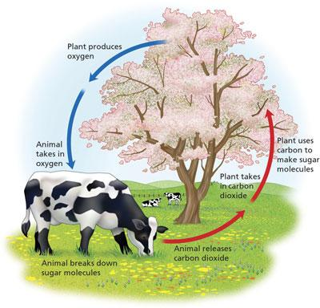
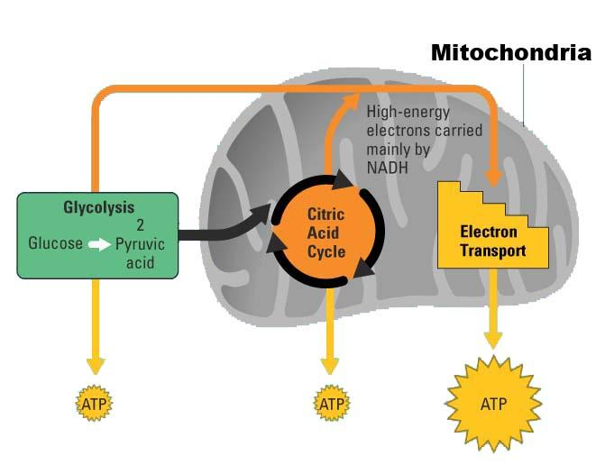
Cellular Respiration Equation
C₆H₁₂O₆ + 6O₂ --> 6 CO₂ + 6H₂O + 36 ATP
Sugar + oxygen --> carbon dioxide + water + cell energy

Slide 6
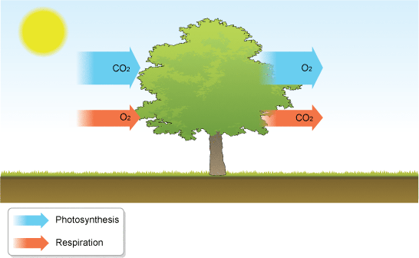
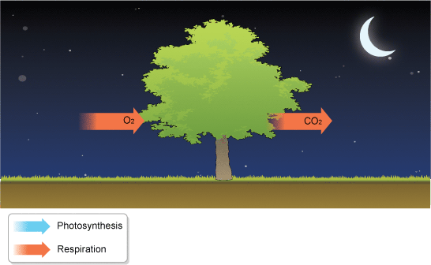
How plants affect the atmosphere: day
Respiration & Photosynthesis
How plants affect the atmosphere: night
Respiration Only

Slide 7
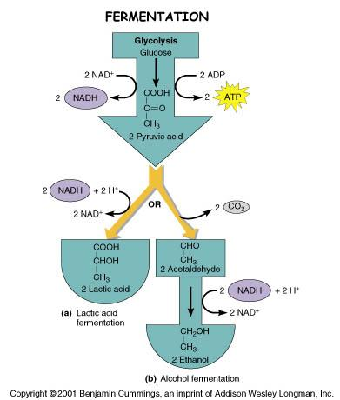
Aerobic Respiration occurs in the presence of oxygen.
Without oxygen,
another path is taken.
....this path is called fermentation,
or
anaerobic respiration

Slide 8
There are three stages
1. Glycolysis
2. Kreb's Cycle (Citric Acid Cycle)
3. Electron Transport Chain

Slide 9
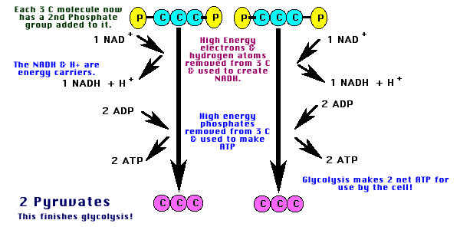
GLYCOLYSIS
can occur without oxygen
Step 1: GLYCOLYSIS = "glyco - lysis "
is the splitting of a 6 carbon glucose into
two pyruvates, each having 3 carbons.
-net yield of 2 ATP per glucose molecule -net yield of 2 NADH per glucose molecule

Slide 10
Step 1: GLYCOLYSIS

Slide 11
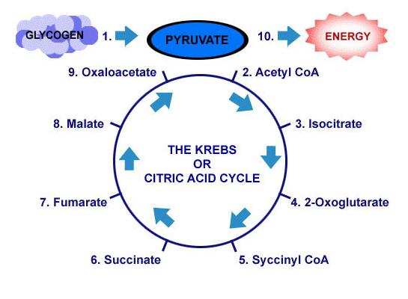
Step 2. Citric Acid or Krebs Cycle
It is not necessary to know the individual steps!
a) occurs in the mitochondria b) an aerobic process; will proceed only in the presence of O₂.

Slide 12
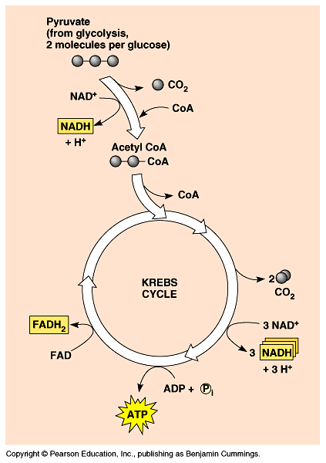
[Continued]
net yield of 2 ATP
net yield of 6 NADH
and 2 FADH2 --> sent to
Electron Transport Chain
c) in this stage of cellular respiration, the oxidation of glucose to CO₂ is completed.
(this is why we exhale carbon dioxide)

Slide 13
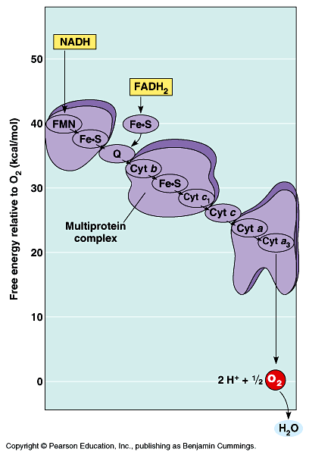
3. Electron Transport System:
consists of a series of enzymes on the inner mitochondrial membrane
b) electrons are released from NADH and from FADH2 and as they are passed along the series of enzymes, they give up energy which is used to fuel a process called chemiosmosis
which drives ATP synthesis!

Slide 14
c) net yield of 32 or 34 ATP per glucose molecule
d) 6 H₂O are formed when the electrons unite with O₂* at the end of electron transport chain.
* Note: This is the function of oxygen in living organisms!
Without oxygen to serve as the final electron acceptor, the process shuts down.

Slide 15
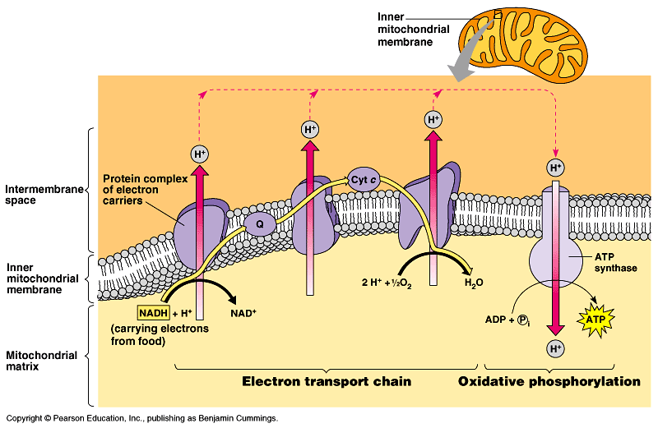
Does this picture look familiar?
You've seen this before in photosynthesis.
Animation of the ETC McGraw Hill Animation
Video Clip Glycolysis

Slide 16
Fermentation
This happens when the Krebs Cycle cannot occur due to lack of oxygen.
Two types:
-Lactic Acid Fermentation
- Alcoholic Fermentation
Byproducts of fermentation include:
lactic acid and alcohol
Lactic Acid in muscle cells can cause muscle cramps.

Slide 17
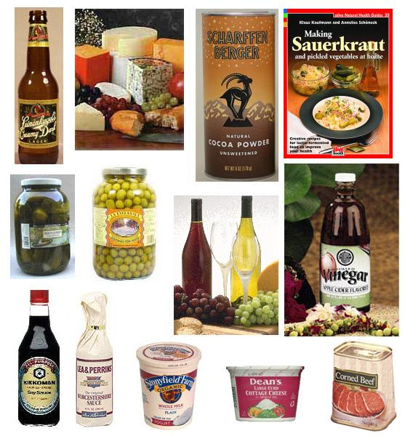
Fermentation is used in making
food & beverage products.

Slide 18
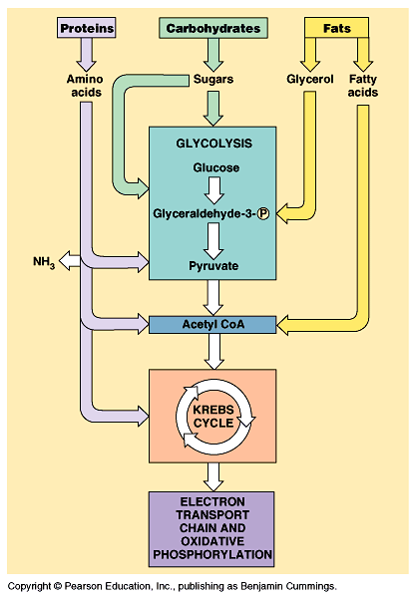
What are the 3 stages of cellular respiration?
1.
2.
3.

Slide 19
Food for thought . . .
1. What is the purpose of cellular respiration?
2. Where does cellular respiration occur within the cell?
3. What is the waste product of cellular respiration?

Slide 20
4. Compare Photosynthesis to Respiration
a. Where does each occur?
b. What are the products of each?
c. What compounds are needed to start the processes?
d. What is the function of the electron transport chain in each process
e. Describe the role of ATPase in both processes.

Slide 21
Self Test
1. In order to produce energy, cells start with glycolysis. If oxygen is NOT present after glycolysis, what process occurs next? a) Electron Transport Chain b) Krebs Cycle c) Fermentation 2. If oxygen IS present after glycolysis, what process occurs next? a) Electron Transport Chain b) Krebs Cycle c)Fermentation
3. A process that does NOT require oxygen is known as what? a) Aerobic b) Anaerobic
4. In glycolysis, glucose is broken into 2 molecules of __________________ acid
5. Where does the Kreb's cycle occur? _________________
6. What gas is a waste product produced in the Krebs cycle? ____

Slide 22
7. What enzyme is used in the electron transport chain to create ATP?
a. citric acid b. pyruvate c. ATPase
8. Where does glycolyis occur?
a. cytoplasm b. mitochondria c. chloroplast
9. Which process produces the largest amount of ATP?
a. fermentation b. Krebs Cycle c. ETC
10. The oxygen required by cellular respiration is reduced and becomes part of which molecule?
a. ATP b. CO₂ c. H₂0

Slide 23
The Mystery of the Seven Deaths
Case Study: http://sciencecases.lib.buffalo.edu/cs/files/cellular_respiration.pdf
In this case study, students learn about the function of cellular respiration and the electron transport chain and what happens when that function is impaired. Students play the role of medical examiner as they analyze the autopsy results to determine the cause of the mysterious deaths of these seven victims.
Explain the overall purpose of cellular respiration.
Describe the intermediate metabolites of cellular respiration.
Explain the function and importance of the electron transport chain.
Describe the role of oxygen in cellular respiration

